Slide 1
Economics 144 Economic Forecasting
Lecture 2
Statistics and Time Series
Dr. Randall R. Rojas

Slide 2
Today’s Class
Introduction
Stochastic Process and Time Series
Stationarity
First Order Strongly Stationary
First Order Weakly Stationary
Second Order Weakly Stationary (Covariance Stationary)
Transformations of Nonstationary Processes
The Autocorrelation Functions
R Example

Slide 3
Introduction 1 of 3
Q1: What is a stochastic process and what is a time series?
Q2: What is the interpretation of a time average or any other time moment?
Q3: What are the new tools of analysis?

Slide 4
Introduction 2 of 3
Given the ‘Time Series Sample’:
What ‘economic mechanism’ generated this sample, and under what conditions?
Examples:
^DJI Stock Price: S_{t}
^DJI Returns: (S_{t} – S_{t-1})/S_{t-1}
Property Crimes
Notes:
Time series sample: Observations over time
Main reason why returns is a better times series: the distribution/you can do a mean reversion

Slide 5
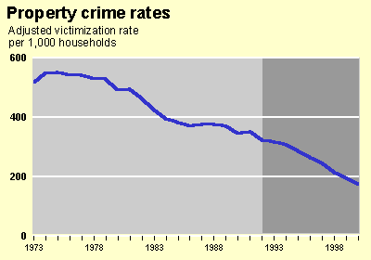
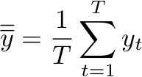
Introduction 3 of 3
Stock Price
Returns
Upward trend Mean reversion trend Downward trend
Q: Is the sample mean an appropriate estimator of the population mean?
Sample Time Mean
Notes:
-Can see a pattern that it reverts back to the mean
-for trend space, you would want to note the momentum, whereas for the returns, you would want to know how frequent it happens

Slide 6
Stochastic Process and Time Series 1 of 2
Def: Stochastic Process
{Y_{t}} = {Y₁, Y₂, …Y_{T}} = Collection of random variables.
Each R.V can have a different μ, σ, and pdf.
2
……………..
t
1
T

Slide 7
Stochastic Process and Time Series 2 of 2
Def: Time Series
{y_{t}; t=1,2,…} = {y₁, y₂, …y_{T}} = Sample realization of a stochastic process.
.
.
Time Series
.
……….
2
……………..
t
1
T

Slide 8
Stationarity 1 of 4
Nonstationary
1
2
……………..
T
t
Stationary
1
2
……………..
T
t
Notes:
-usually we want to model series that are stationary
-for stationary distributions, the distribution might be diff, the mean is the same

Slide 9
Stationarity 2 of 4
Def: First Order Strongly Stationary
= All R.Vs have the same pdf’s (all moments are the same).
→
2
……………..
T
t

Slide 10
Stationarity 3 of 4
Def: First Order Weakly Stationary
= All R.Vs have the same means.
→
1
2
……………..
T
t

Slide 11

Stationarity 4 of 4
Def: Second Order Weakly Stationary
= Covariance Stationary
Means:
Variances:
Time Independent Covariances:
The strength of the linear association between the two R.Vs only depends on how many periods (k) apart they are.
Notes:
-You need to satisfy the variance as well.
-for iii) the covariance does not depend on what is the time, but only on the periods apart

Slide 12
Transformations of Nonstationary Processes
Q: Can we find a transformation of {y_{T}} such that the resulting process is:
(1) first order weakly stationary?
Yes: Take the first difference of the data
(2) second order weakly stationary?
Yes: Take the log of {y_{T}} and then take the first difference of this transformed series.
Interpretation: Economic returns or growth rates.
Notes:
-first difference = yt-yt-1
-2) log(yt)-log(yt-1) = log(yt/yt-1), if you take the log, you preserve the variance since the volatility is more constant

Slide 13
The Lag Operator 1 of 3
Lag Operator(L): Is a linear operator L such that for any value of y_{t} : Ly_{t} =y_{t-1}.
In general, for m-periods L^{m}y_{t} =y_{t-m} .
Polynomial Lag Operator: B(L) =b₀+ b₁L +••• +b_{m}L^{m}
First Difference Operator (Δ): Δy_{t} =(1-L) y_{t} = y_{t}-y_{t-1}

Slide 14
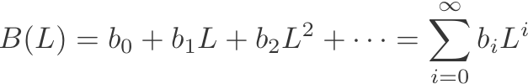
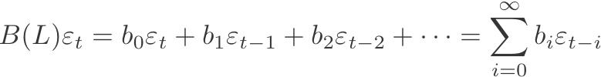
The Lag Operator 2 of 3
Distributed Lag: Consider a second-order lag operator such as (1+0.5L + 0.8L²):
→(1+0.5L + 0.8L²) y_{t} = y_{t} + 0.5y_{t-1} +0.8y_{t-2}
Infinite-Order Lag Operator:
Example: Infinite distributed lag of current and past shocks:
→

Slide 15
The Lag Operator 3 of 3
Dow Jones Index
Covariance
Stationary

Slide 16
The Autocorrelation Functions 1 of 9
Autocovariance Function (γ(t,k)): Autocovariance at displacement k is the covariance between y_{t} and y_{t-k} .
γ(t,k) = cov(y_{t,} y_{t-k} ) =E [(y_{t} - μ)(y_{t-k}- μ)]
Note: γ(t,k) =γ(k), t (if the covariance of the series is stable over time).
Properties of the autocovariance function:
(i) γ(k) = γ(-k), k (symmetric: depends only on displacement)
(ii) γ(0) = cov(y_{t,} y_{t} ) = var( y_{t} )
(iii) max [ |γ(k)| ] < γ(0) → if γ(0)<∞→γ(k) <∞

Slide 17
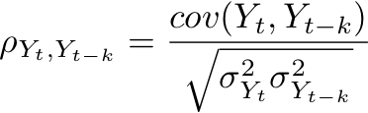
The Autocorrelation Functions 2 of 9
Autocorrelation Function (ρ _{Yt,Yt-k}): ACF
Normalized autocovariance. Does not have any units, therefore it is easier to interpret.
Correlation Coefficients
γ_{k}
γ₀
ACF of a Covariance Stationary Processes
ρ_{k} = , k = 0,1, 2, …

Slide 18
The Autocorrelation Functions 3 of 9
Example: Annual Hours Worked per Person Employed in Germany
ACF
Autocorrelation Function
k | 1 | 2 | 3 | 4 | 5 | 6 | 7 | 8 | 9 | 10
 | .22 | .29 | -.10 | .16 | -.01 | .19 | -.06 | -.04 | .09 | .20
Autocorrelogram

Slide 19
Percentage Change in Working Hours in Germany:
Calculation of the Autocorrelation Coefficients
1978 | -1.0604
1979 | -0.6699 | -1.0604
1980 | -1.1018 | -0.6699
1981 | -1.2413 | -1.1018 | -1.0604
1982 | -0.6497 | -1.2413 | -0.6699
1983 | -0.7536 | -0.6497 | -1.1018
1984 | -0.6826 | -0.7536 | -1.2413
1985 | -1.3733 | -0.6826 | -0.6497
1986 | -1.1438 | -1.3733 | -0.7536
1987 | -1.3533 | -1.1438 | -0.6826
1988 | -0.3196 | -1.3533 | -1.3733
1989 | -1.4574 | -0.3196 | -1.1438
1990 | -1.4536 | -1.4574 | -1.3533
1991 | -2.0234 | -1.4536 | -0.3196
1992 | -0.5904 | -2.0234 | -1.4574
1993 | -1.4550 | -0.5904 | -1.4536
1994 | 0.0264 | -1.4550 | -2.0234
1995 | -0.7087 | 0.0264 | -0.5904
1996 | -0.9752 | -0.7087 | -1.4550
1997 | -0.5249 | -0.9752 | 0.0264
1998 | -0.2026 | -0.5249 | -0.7087
1999 | -0.7057 | -0.2026 | -0.9752
2000 | -1.2126 | -0.7057 | -0.5249
2001 | -0.8375 | -1.2126 | -0.2026
2002 | -0.7745 | -0.8375 | -0.7057
2003 | -0.4141 | -0.7745 | -1.2126
2004 | 0.2950 | -0.4141 | -0.8375
2005 | -0.2879 | 0.2950 | -0.7745
2006 | -0.0492 | -0.2879 | -0.4141
Mean: | -0.8026
Variance: | 0.2905
(k= 1,3) |  | 0.0651 | -0.0282
(k= 1,3) |  | 0.2240 | -0.0970

Slide 20

The Autocorrelation Functions 5 of 9
Example: Annual Hours Worked per Person Employed in Germany
Interpretation: Since the autocorrelations are small, there is little dependence on how working hours have changed over time.
ACF
Autocorrelogram
Interpretation of :
k=1 → Observations that are 1 year apart, move in the same direction. When Germans increase their working hours, one year later we expect to see an increase.
Notes:
-ACF is much better to deal with short term memory, since it teases out the short term dynamics
-ACF though doesn’t work well with long term memory

Slide 21

The Autocorrelation Functions 6 of 9
Partial Autocorrleation Function (p_{t}(k)): PACF
Provides information about the autocorrelataion between Y_{t} and Y_{t+k} after removing all the observation in between.
Sample Partial Autocorrelation: Given the fitted regression:
→ (sample partial autocorrelation)
Note: See Page 70 Textbook (1)

Slide 22

The Autocorrelation Functions 7 of 9
Statistical tests for ρ_{t}(k) and p_{t}(k)
Assume we e would like to test, e.g., the null hypothesis H₀: ρ_{k} = 0 against the alternative
H₁: ρ_{k} ≠ 0.
If the sample is large enough, then:

Slide 23
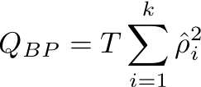
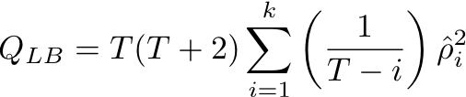
The Autocorrelation Functions 8 of 9
Box-Pierce Q-Statistic:
Ljung-Box Q-Statistic:
Statistical tests of whether any of a group of autocorrelations of a time series are different from zero.
Both test are really testing the joint null hypothesis:
H₀: ρ₁ = ρ₂ = ••• = ρ_{k} = 0

Slide 24


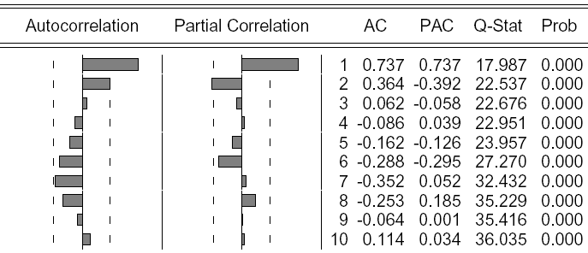
The Autocorrelation Functions 9 of 9
Example: Annual Working Hours per Employee in the US vs. Germany.
US Data: ACF & PACF
There is a statistically
significant time
dependence.
Notes:
-the dashlines are Bartnet windows

Slide 25
For Next Class
Readings about today’s class:
Chapters 3ª
Readings for next class:
Chapters 4ª and 4^{b}

